Slide 1
Wlp-based verification engine
Ferdinand van Walree & Matthew Swart

Slide 2
Agenda
Introduction
Implementation overview
Example/Questions

Slide 3
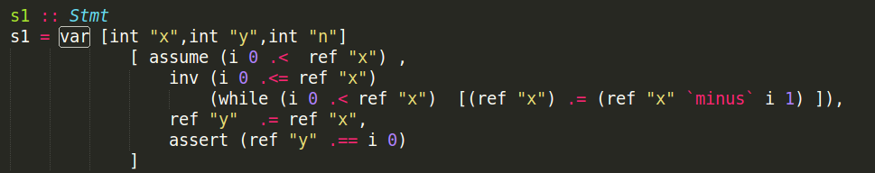
Introduction
Prover: Z3
Language: Haskell
Package: Data.SBV

Slide 4
Implementation overview
Base implementation
Simultaneous assignments
Array assignments
Program call

Slide 5
Array assignments
GCL: a := a(i repby 3)
a[i] := 3
a[i] := 3
ref “a” `withIndex` ref “i” .= 3

Slide 6
Array assignments - Collection
Collect vars
Collect refs
Collect Programs
sem Expr | Repby lhs.allVars = S.union @expr1.allVars @expr2.allVars lhs.allRefs = S.union @expr1.allRefs @expr2.allRefs
Var [int “i”, int “j”, array “a”] [ ref “a” `indexWith` ref “i” .= ref “a” `indexWith` ref “j” ]

Slide 7
Array assignments - Transforming
mkFreshExpr :: Int -> M.Map String String -> Expr -> (Int,Expr) mkFreshExpr n varMap (Repby e1 e2) = let (n1,expr1) = mkFreshExpr n varMap e1 (n2,expr2) = mkFreshExpr n1 varMap e2 in (n2, Repby expr1 expr2)
tmp = a[i] a[i] = a[j] a[j] = tmp
tmp1 = a0[i0] a0[i0] = a0[j0] a0[j0] = tmp1

Slide 8
Array assignments - WLP
Added case to wlp
Added case to assign
wlp :: [Var] -> Stmt -> Expr -> IO ([Expr],Expr) wlp vars (Assign (ArrayIndex (Name s) i) e2) q = do let pre = assign q (s, i) e2 return $ ([],pre)
assign :: Expr -> (String, Expr) -> Expr -> Expr
assign (ArrayIndex (Name s) index) ref expr
| s == fst ref && index == snd ref = expr
| s == fst ref = ArrayIndex expr (assign index ref expr)
| otherwise = ArrayIndex (Name s) (assign index ref expr)

Slide 9
Array assignments - Z3 prover
Collect refs → fill maps -> make predicate -> Prove predicate
mkPred :: M.Map String SInteger -> M.Map String (SArray Integer Integer) -> Expr -> Predicate mkPred vars arr (Equal e1 e2) = do p1 <- mkSymEq vars arr e1 case p1 of Left sInt1 -> do Left sInt2 <- mkSymIntArr vars arr e2 return $ sInt1 .== sInt2 Right sArr1 -> do Right sArr2 <- mkSymIntArr vars arr e2 return $ sArr1 .== sArr2
mkSymInt :: M.Map String SInteger -> M.Map String (SArray Integer Integer) -> Expr -> Symbolic SInteger mkSymInt vars arr (Repby (Name s) (Lit index)) = return $ readArray (fromJust $ M.lookup s arr) index

Slide 10
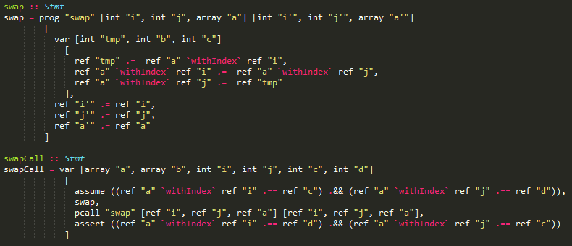
Demo

